Slide 1
Pseudomonas
Prepared by
Assistant Professor Reham M.M. AL-Mosawi
Medical Microbiology

Slide 2
Pseudomonas
The pseudomonads are gram-negative, motile, aerobic rods some of which produce water-soluble pigments. The pseudomonads occur widely in soil, water, plants, and animals.
P aeruginosa is frequently present in small numbers in the normal intestinal flora and on the skin of humans and is the major pathogen of the group.

Slide 3
Pseudomonas aeruginosa
P aeruginosa is widely distributed in nature and is commonly present in moist environments in hospitals. It can colonize normal humans, in whom it is a saprophyte. It causes disease in humans with abnormal host defenses.

Slide 4
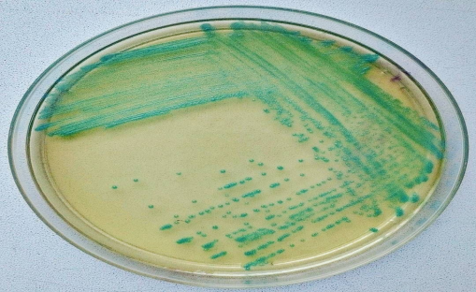
Morphology & Identification
A. P aeruginosa is motile and rod shaped, measuring about 0.6 × 2 μm. It is gram negative and occurs as single bacteria, in pairs, and occasionally in short chains.
B. Culture:
*It is an obligate aerobe
*sometimes producing a sweet or grapelike or corn taco–like odor.
*Some strains hemolyze blood.
*P aeruginosa forms smooth round colonies with a fluorescent greenish color:
bluish pigment pyocyanin, which diffuses into the agar. pyoverdin, which gives a greenish color to the agar.
Some strains produce the dark red pigment pyorubin or the black pigment pyomelanin.

Slide 5
P aeruginosa grows well at 37–42°C; its growth at 42°C helps differentiate it from other Pseudomonas species in the fluorescent group.
*It is oxidase positive.
* It does not ferment carbohydrates, but many strains oxidize glucose.
Identification: is usually based on *colonial morphology, *oxidase positivity, *the presence of characteristic pigments, *and growth at 42°C.
P aeruginosa and other pseudomonads are resistant to many antimicrobial agents and therefore become dominant and important when more susceptible bacteria of the normal microbiota are suppressed.

Slide 6
Lab diagnosis
Specimens: Specimens from skin lesions, pus, urine, blood, spinal fluid, sputum, and other material should be obtained as indicated by the type of infection.
Smears Gram-negative rods are often seen in smears. No specific morphologic characteristics differentiate pseudomonads in specimens from enteric or other gram-negative rods.
Culture Specimens are plated on blood agar and the differential media commonly used to grow the enteric gram-negative rods. Pseudomonads grow readily on most of these media, but they may grow more slowly than the enterics. P aeruginosa does not ferment lactose and is easily differentiated from the lactose-fermenting bacteria. Culture is the specific test for diagnosis of P aeruginosa infection.

Slide 7
Thank you

